Slide 1
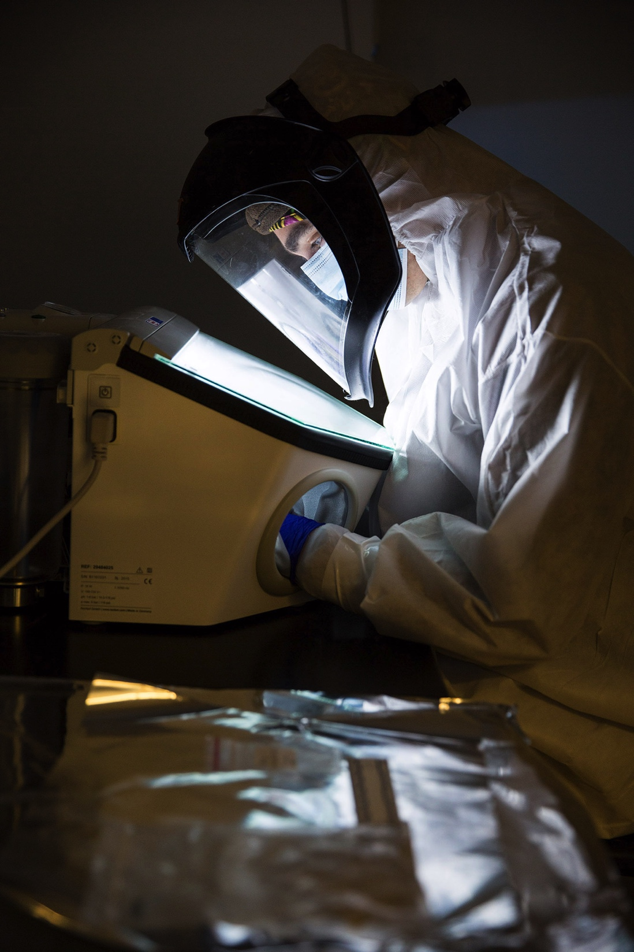
Who We Are and How We Got Here
Ancient DNA and the New Science of the Human Past
David Reich
Harvard Medical School Department of Genetics
Harvard Department of Human Evolutionary Biology
Howard Hughes Medical Institute
Broad Institute of MIT and Harvard
Whitehead Institute High School Teachers Program
June 7, 2021
Notes:
At the end of this talk I hope you will be convinced that population history is not just interesting in its own right.
The goal of this talk is to convince you that the historical perspective provides insights about biology that are profoundly important and are difficult to obtain with other approaches.

Slide 2
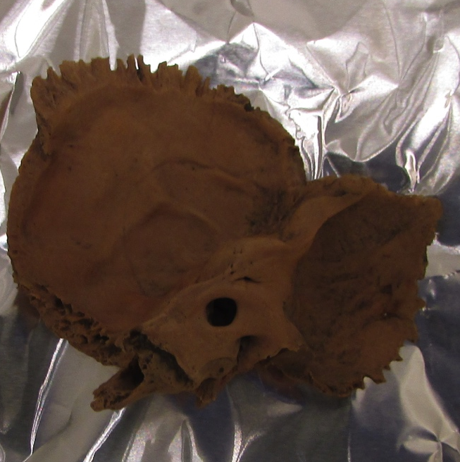
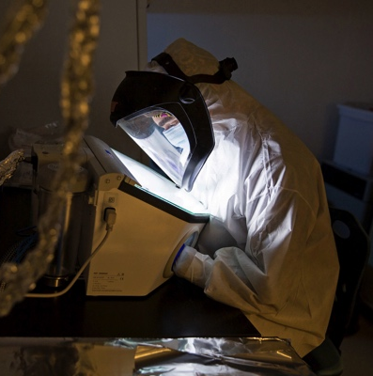
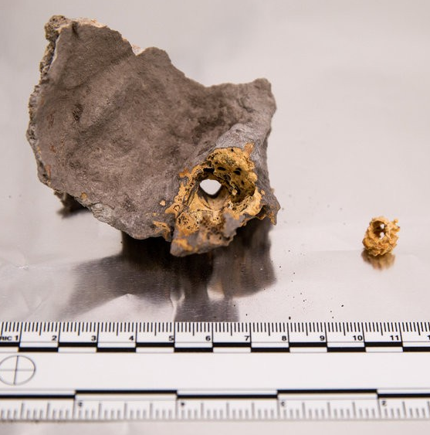
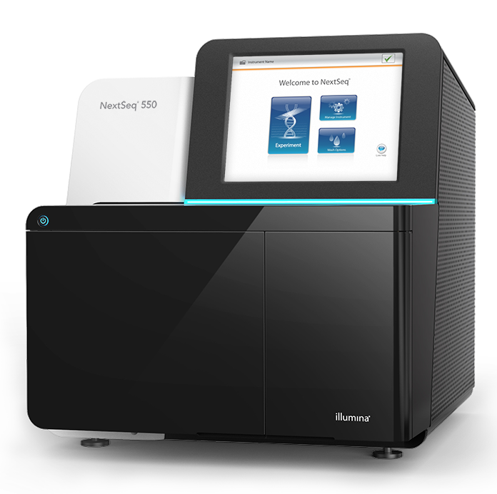
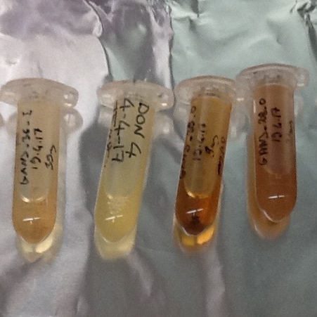
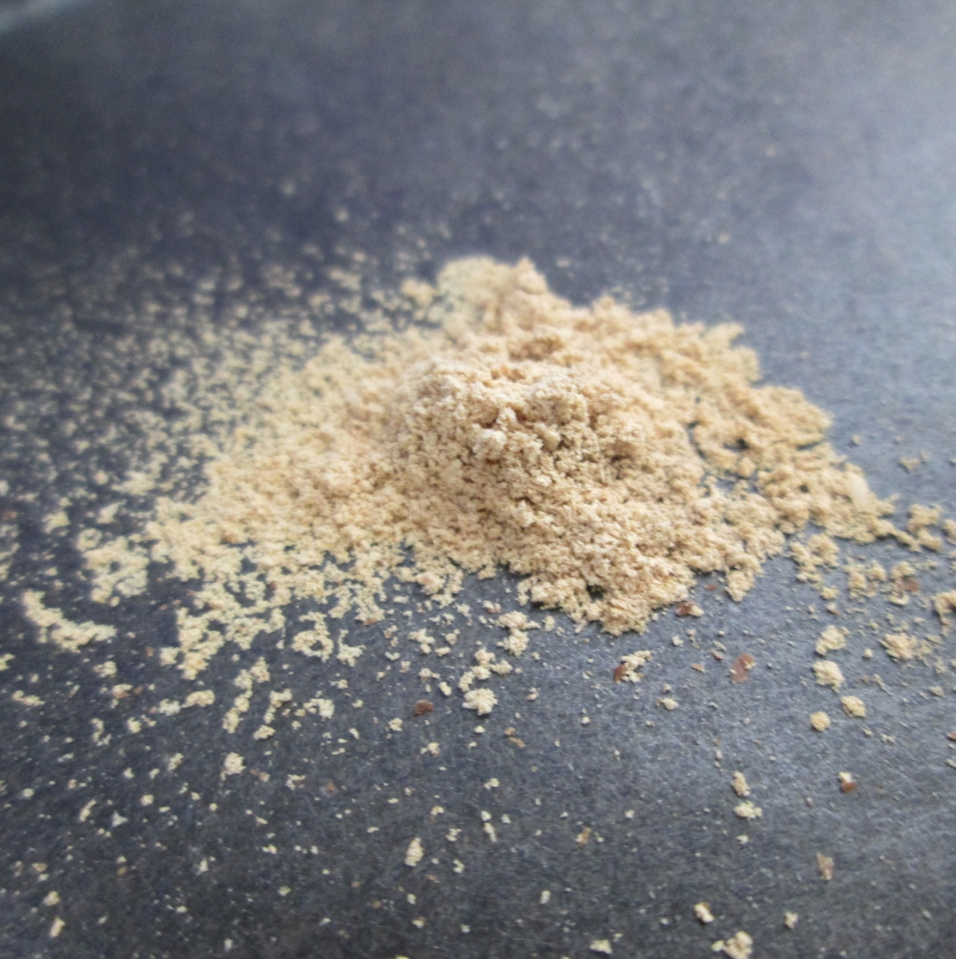
A new scientific instrument
Bones
Clean room
Prepare
Sequencing
Purification
Powder
Notes:
A new scientific instrument like a microscope or telescope
The measure of the revolutionary power of a new scientific instrument is how much it shows when it is used
Here is how it works

Slide 3
Moore’s Law of Ancient DNA
Notes:
This idea drove the 100-fold increase in ancient DNA data size since 2013
My laboratory contributed more than half the world’s ancient DNA in this time, reported in these publications.

Slide 4
Four surprises
Notes:
At the end of this talk I hope you will be convinced that population history is not just interesting in its own right.
The goal of this talk is to convince you that the historical perspective provides insights about biology that are profoundly important and are difficult to obtain with other approaches.

Slide 5
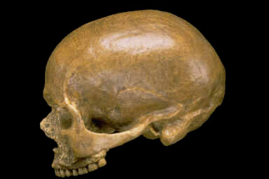
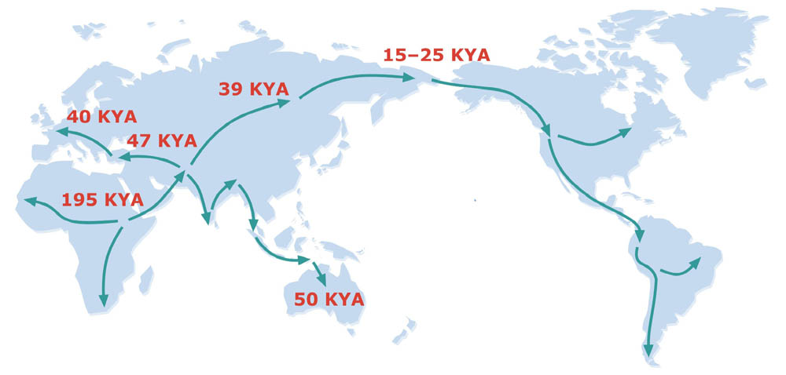
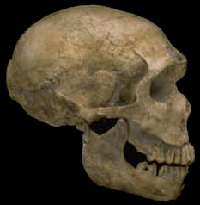
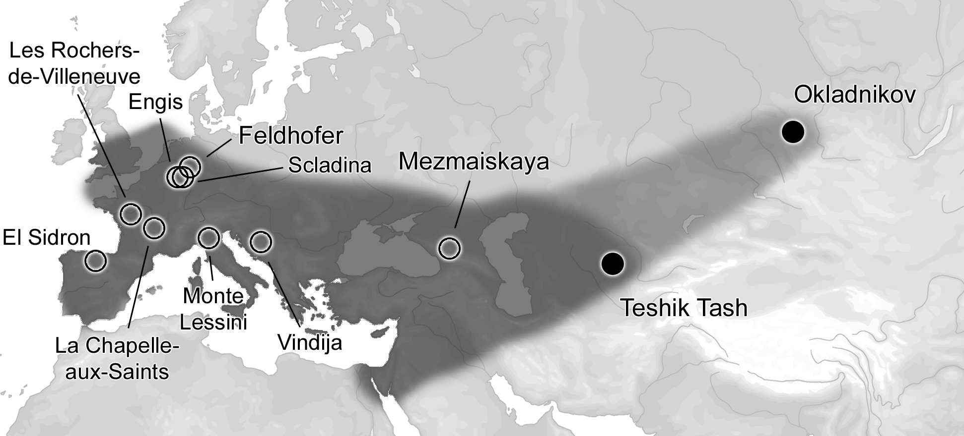
First surprise – Archaic Humans
Cro-Magnon
“Modern” humans:
~300,000 years ago to present
Neandertals:
~400,000-40,000 years ago
La Ferrassie

Slide 6
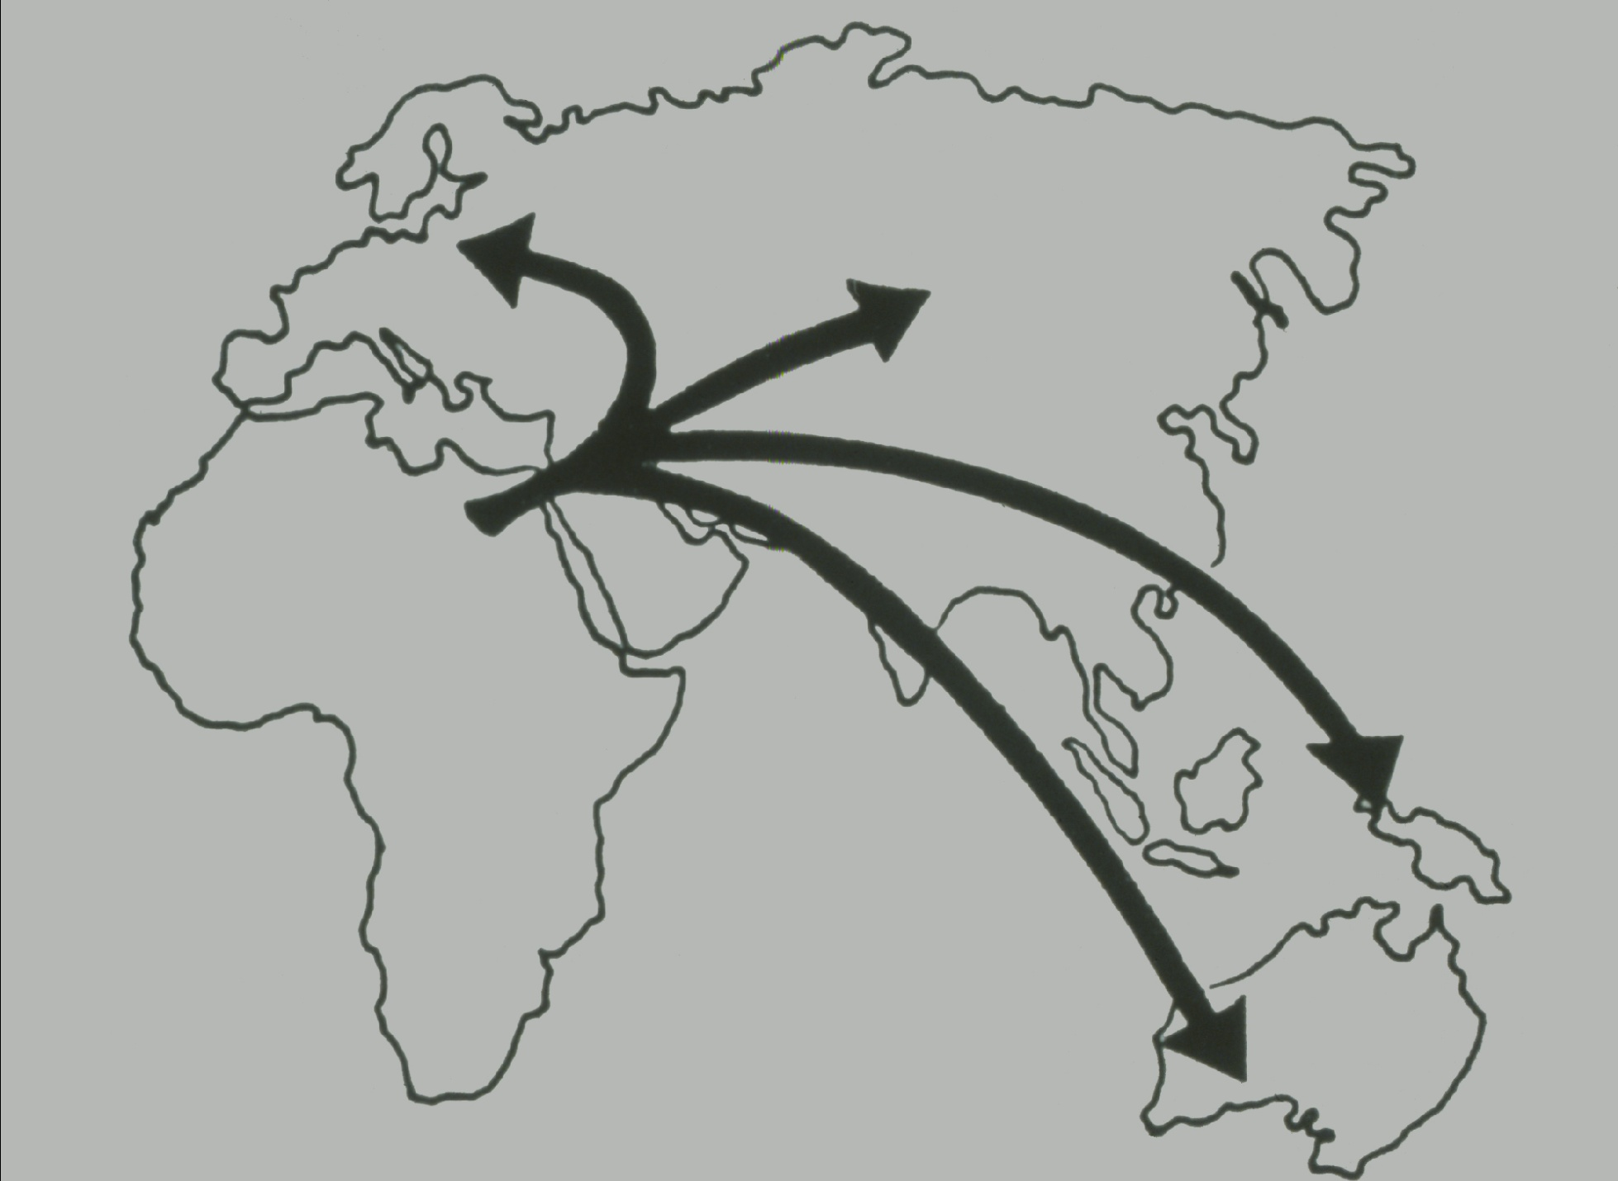
Was there interbreeding?
?
?
?
?

Slide 7
Test for gene flow
Does Neandertal match some humans than others?
Neandertal
(derived allele)
T?
G?
French
Yoruba
T
G
92,066
>>
84,025
Very significant: 10.5 stand. dev.
Green et al. 2010

Slide 8
Estimated Neandertal gene flow is ~2%
Altai Neandertal
Nigerian
Non-African
Mezmaiskaya Neandertal
T?
G?
T
G
“How much of the way is a non-African to a Neandertal?”
1.72 ± 0.12% Europeans
1.89 ± 0.13% East Asians
Green et al. 2010; Prufer et al. 2014

Slide 9
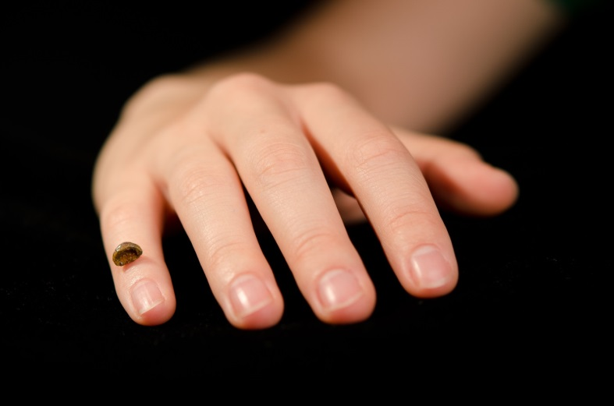
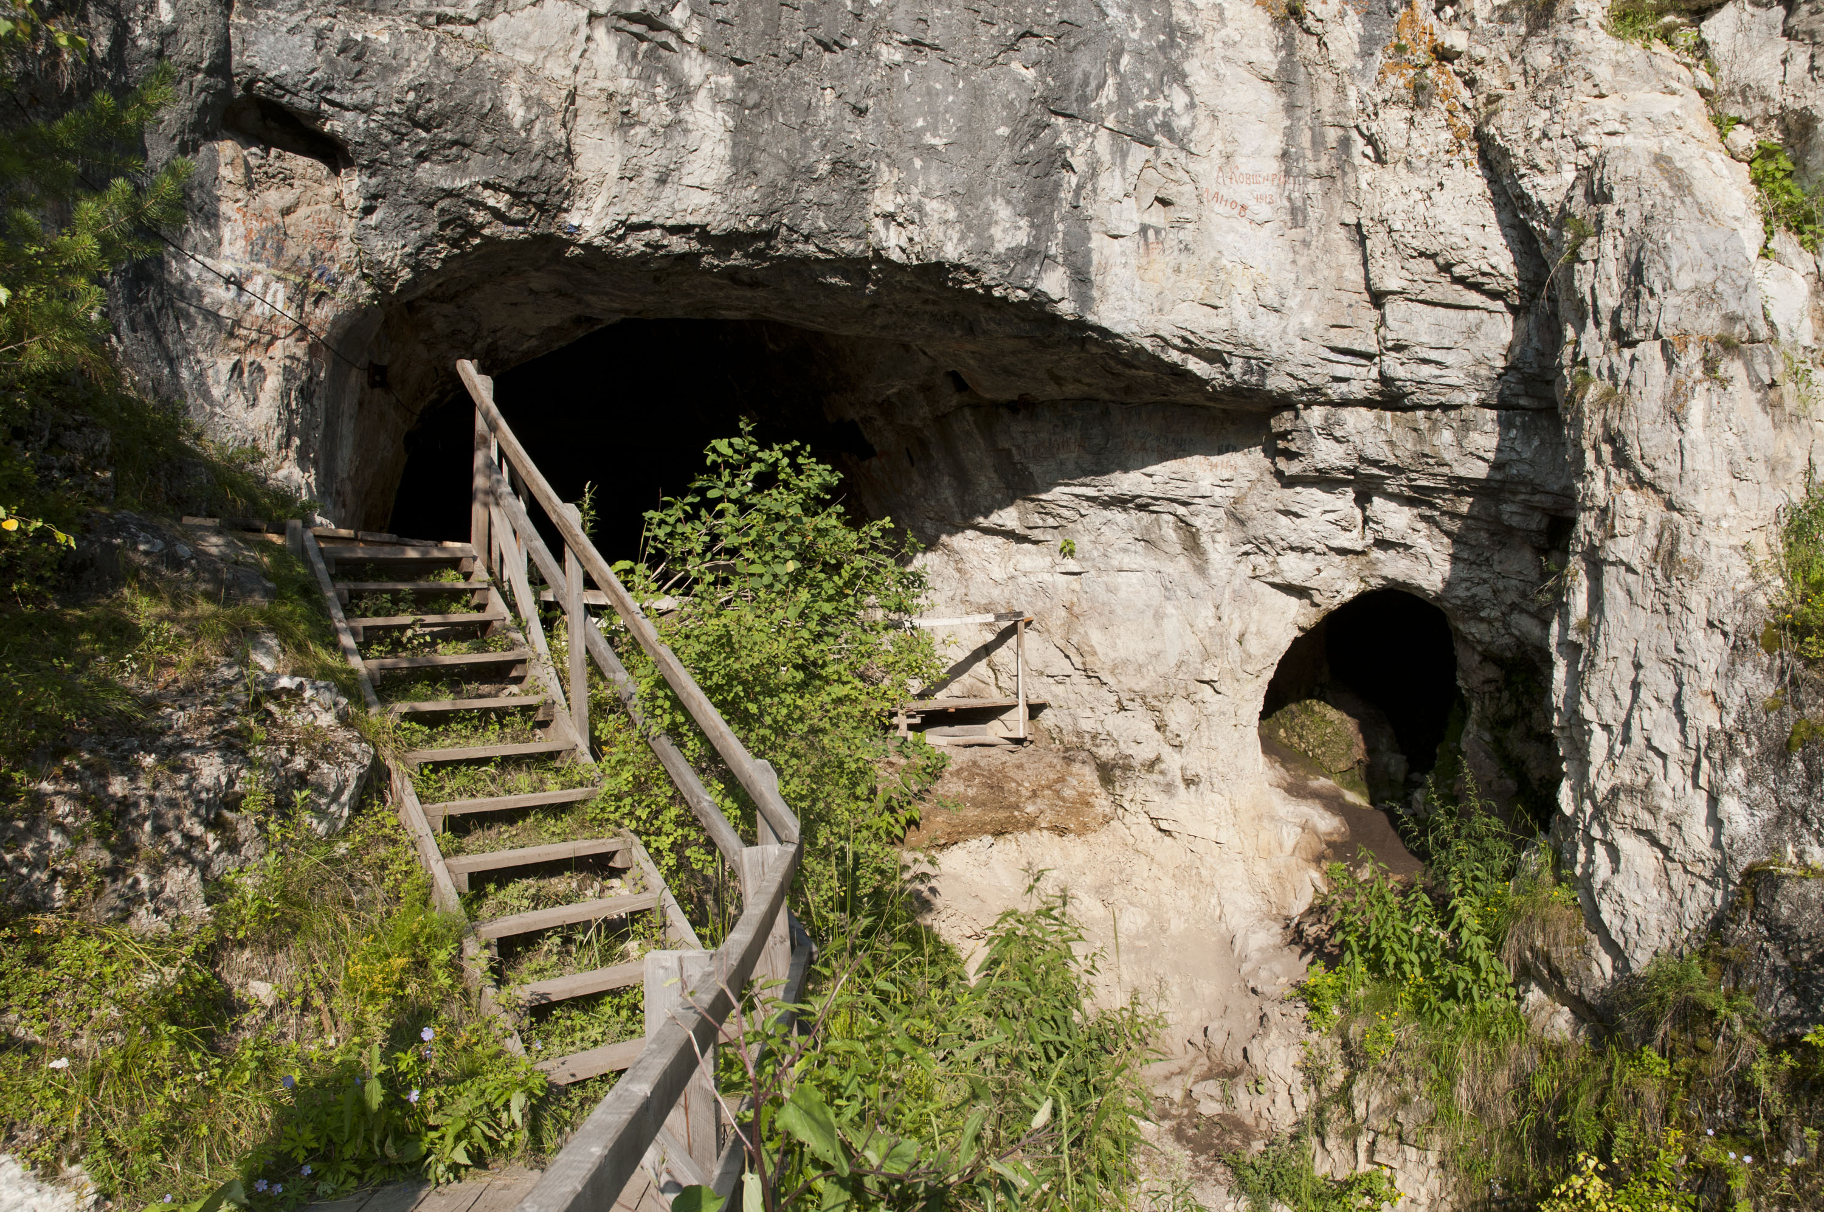
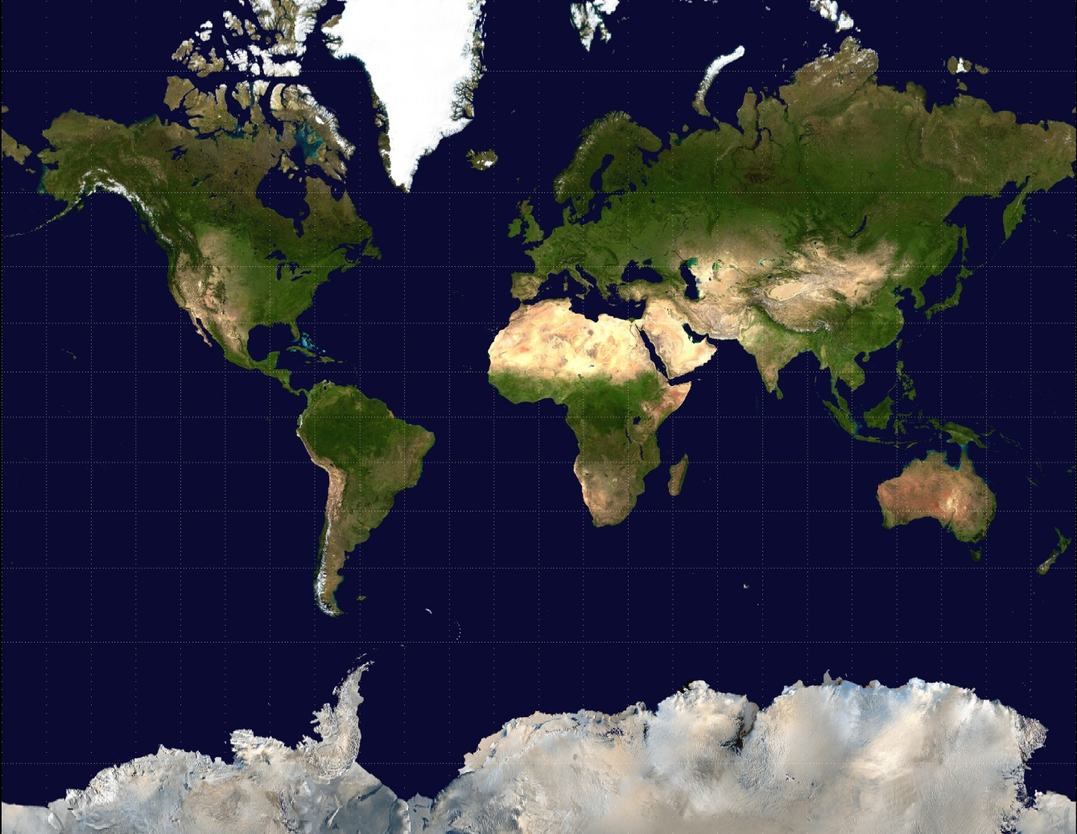
Denisova – A Genome in Search of a Fossil Record
Notes:
And if you seek you eventually find something and that something is one of the smallest bones in the body the tip of a pinky finger. The phalanx was found in this cave, Denisova cave in the Altai mountains in 2008.

Slide 10
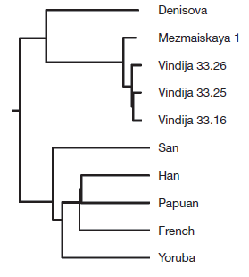
“Denisovans” are a distinct group separated by ~400,000 years from Neanderthals

Slide 11
Does Denisova match some humans than others?
Reich, Green et al. 2010
Denisova
(derived allele)
T?
G?
New Guinean
Chinese
T
G
24,198
>>
22,262
Very significant: 5.8 stand. dev.
Estimated to contribute 4-6% of New Guinean ancestry

Slide 12
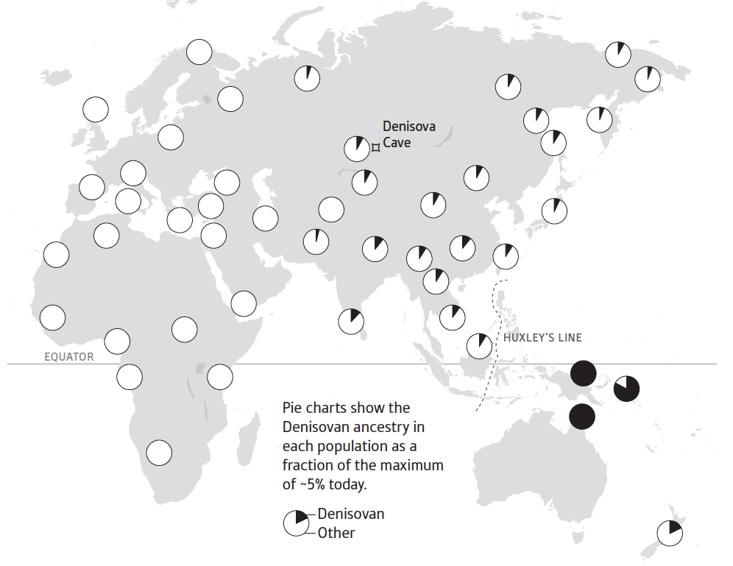
Denisova genes widespread east of Wallace Line
Reich et al. 2011; Reich (2018) Who We Are and How We Got Here: Ancient DNA and the New Science of the Human Past

Slide 13
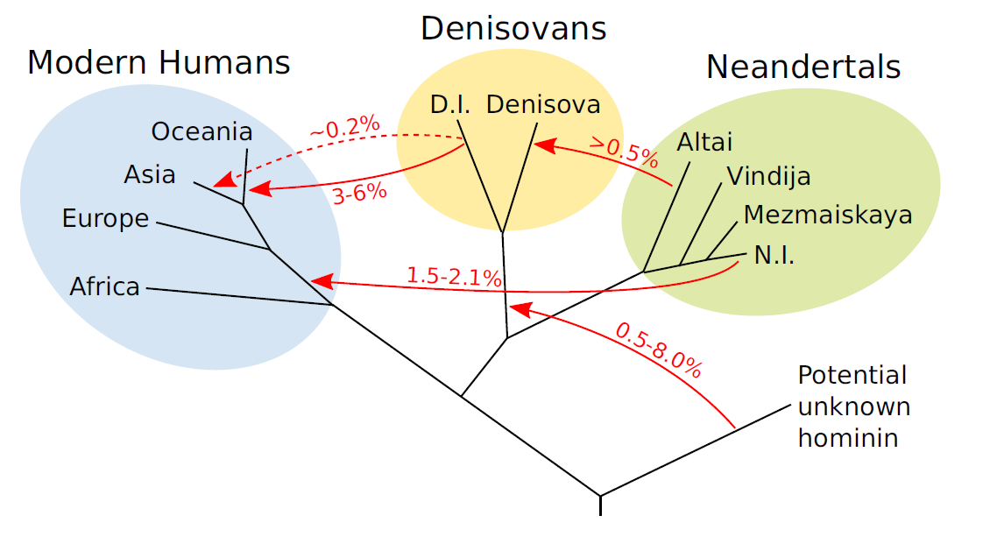
Pandora’s Box of Archaic Mixtures
Prufer et al. 2014

Slide 14
Second surprise – “White People” are a recent phenomenon
Derived from 4 sources as different from each other as Europeans / East Asians
Lazaridis et al. Nature 2016
Western European foragers
>8,000 years ago
Eastern European foragers
Levant farmers
Eastern European foragers
Iran farmers
Western European foragers
Blue Eyes
Blonde Hair
~6000 years ago
Iran farmers
~3-fold reduction in differentiation due to mixture
Levant farmers
~4,000 years ago
By 4,000 years ago we observe present-day low population differentiation
Notes:
As a first example of the profound transformative impact of this technology, our analysis showed how “White people” today – a group of low differentiation extending from Central Asia to Western Europe – is not in fact an anciently established population.
We showed that population differentiation in this region as recently as ~8,000 years ago was similar to Europeans and East Asians today.
None of these groups disappeared. Instead, they collapsed into each other via migration and mixture.

Slide 15
Before 5,000 years ago Europeans were a mixture of two ancestries but today there is a third
Lazaridis et al. Nature 2014; Haak et al. Nature 2015
>5,000 years ago
Farmer Forager
Present day Europeans
Third ancestry
0% 20% 40% 60% 80% 100%
0% 20% 40% 60% 80% 100%
When did third ancestry arrive?
Notes:
In ancient DNA studies before 2015, we and others showed that prior to ~5,000 years ago there were just two primary ancestral populations in Europe: the hunter-gatherers and the farmers.
But today, thee was a third ancestral population.
When between these times did it arrive and in association with what archaeological cultures?

Slide 16
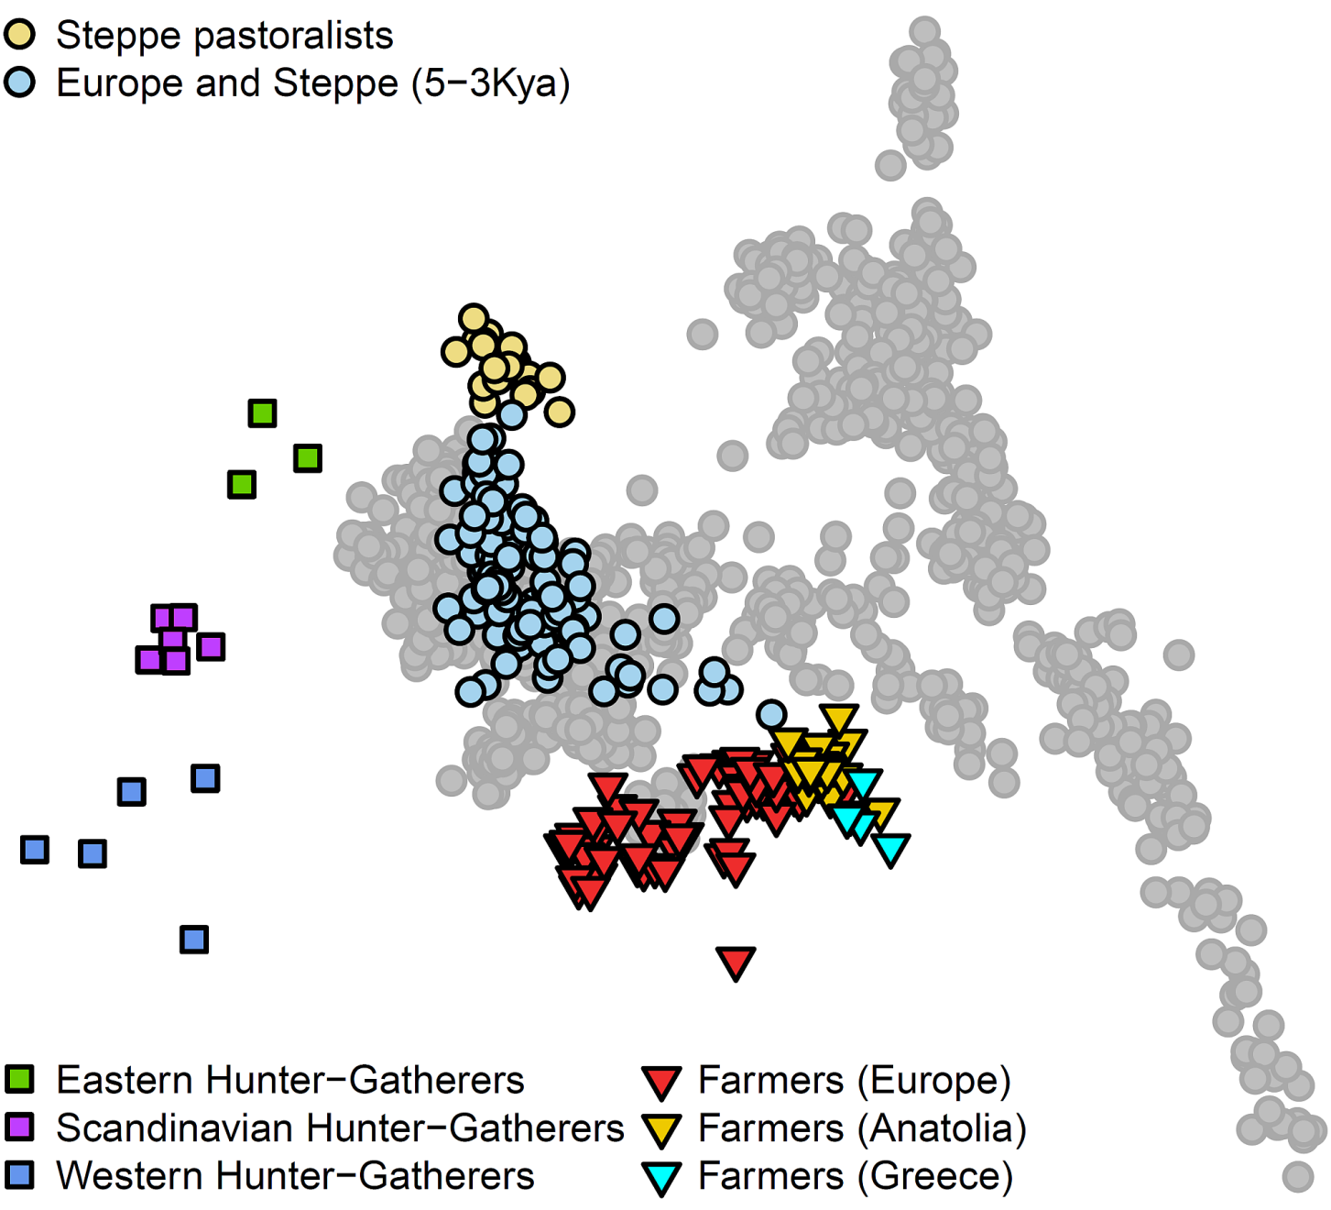
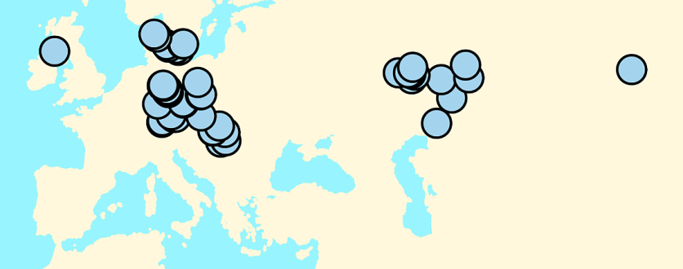
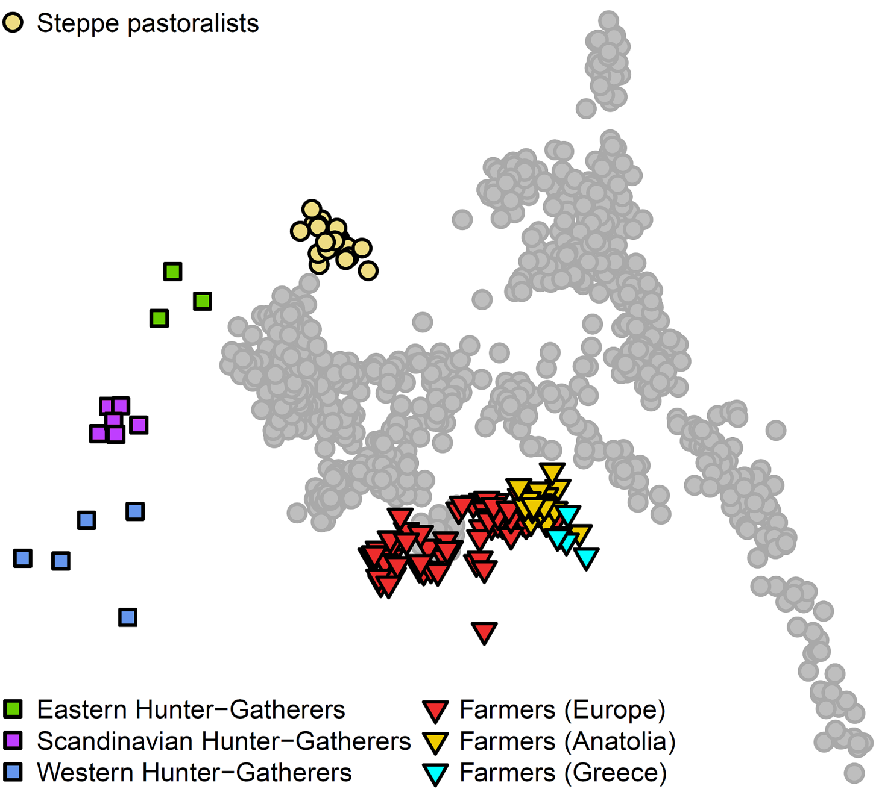
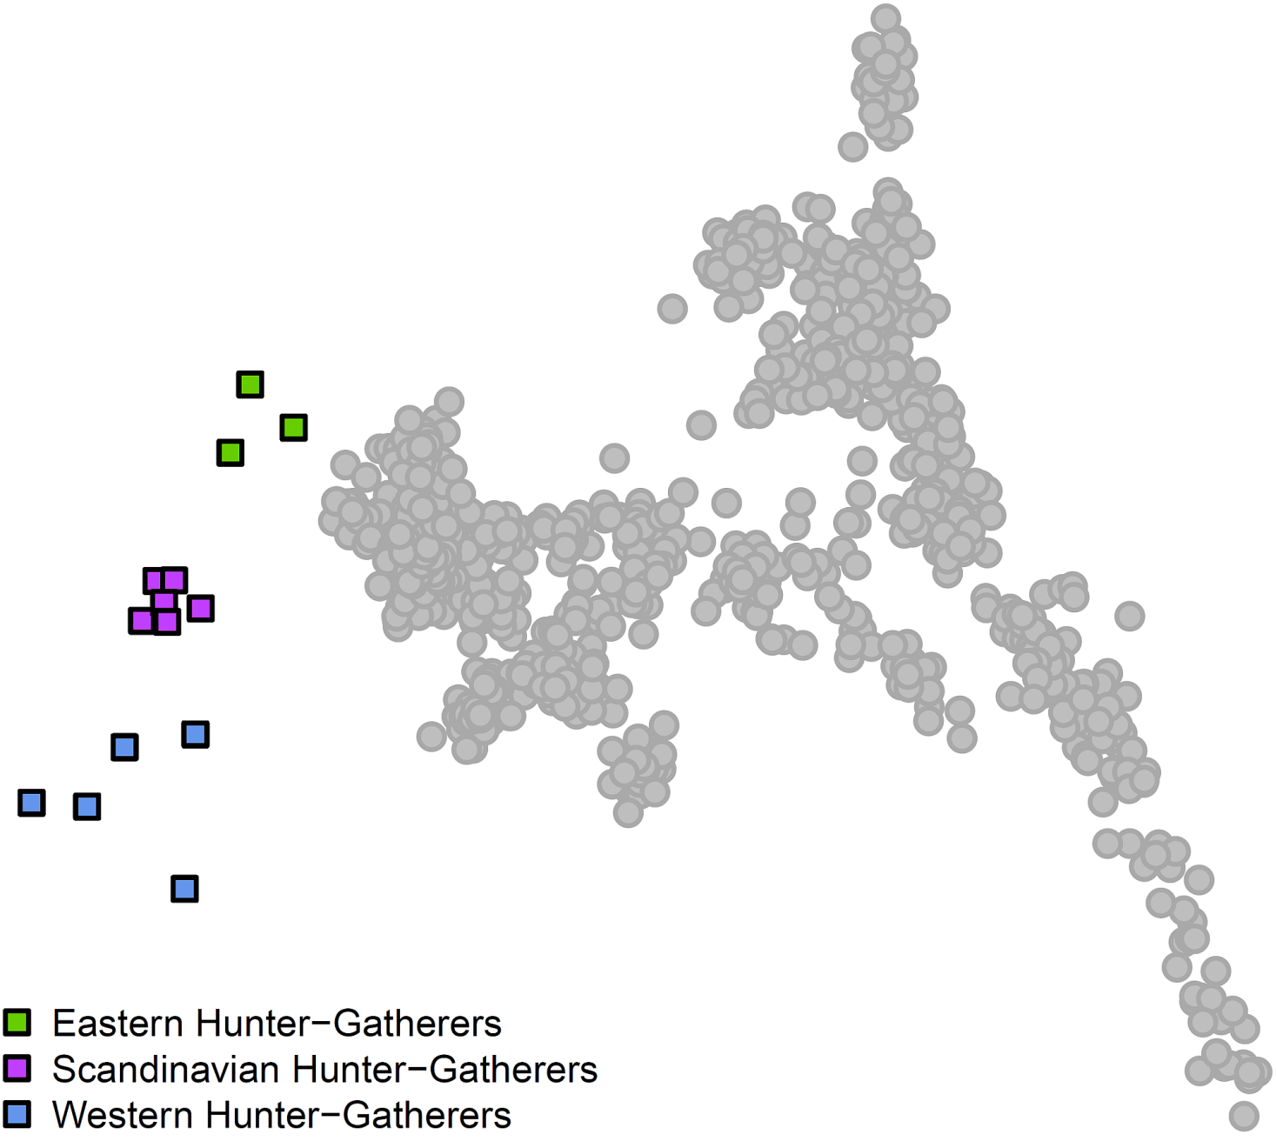
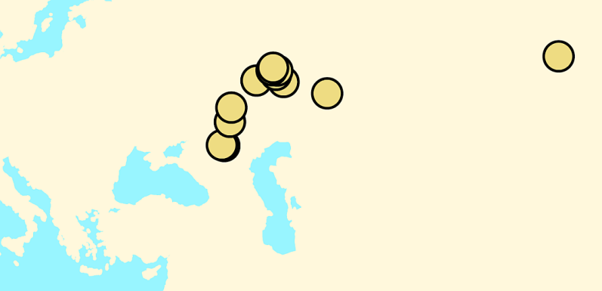
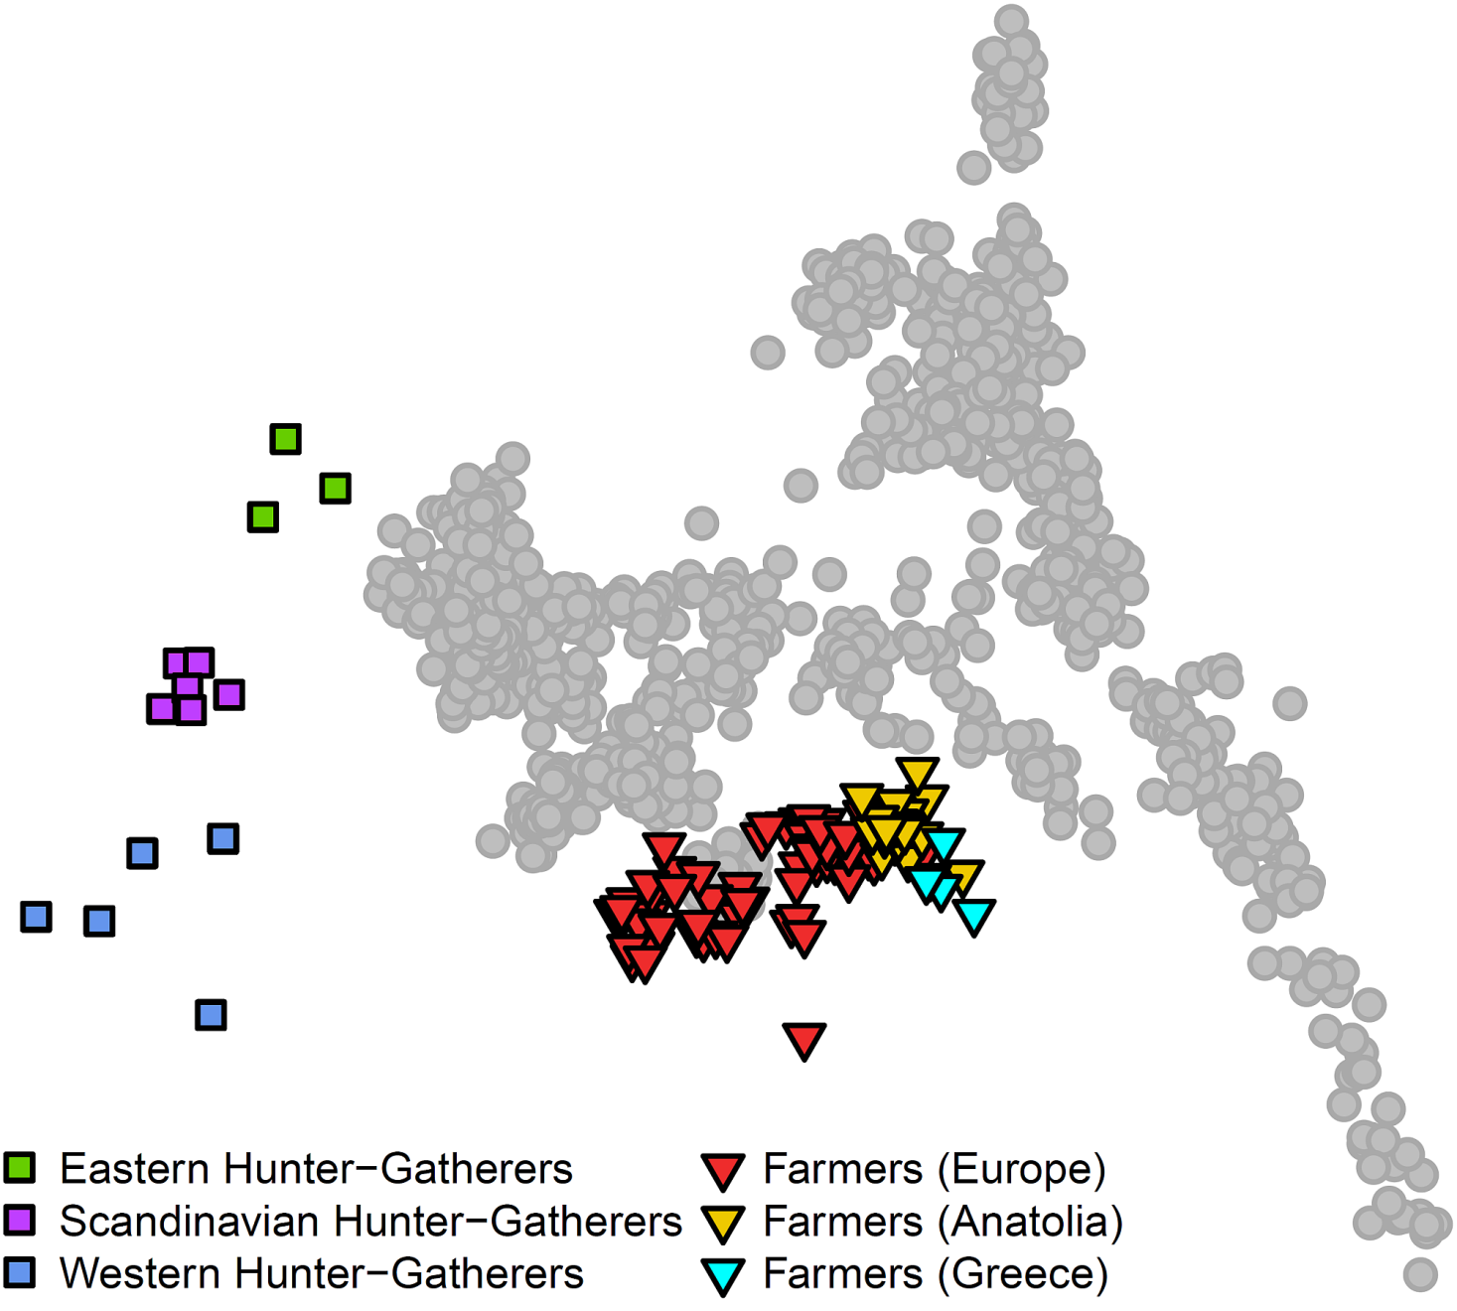
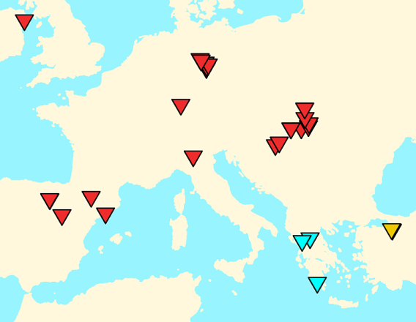
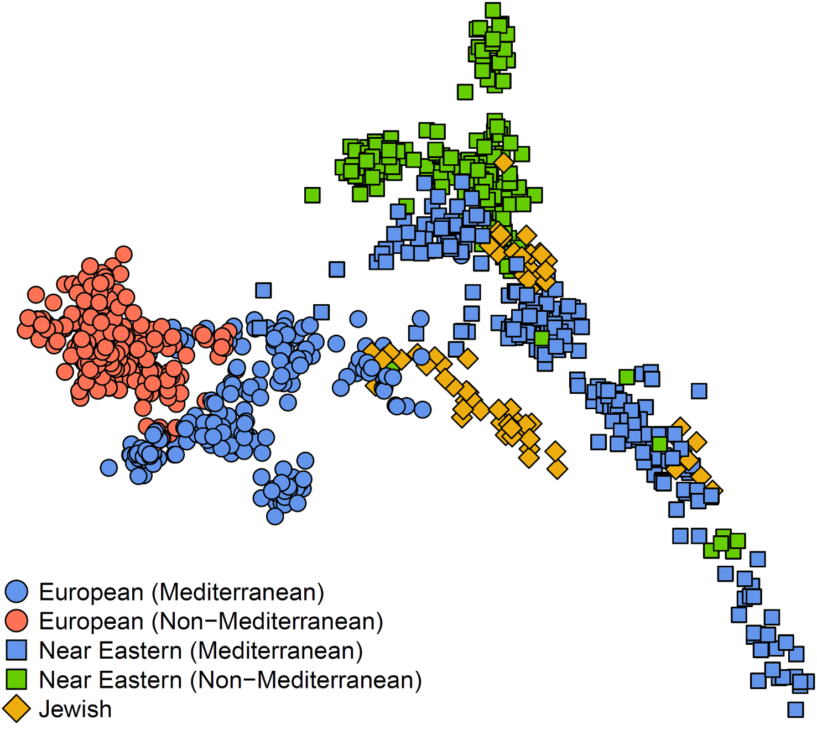
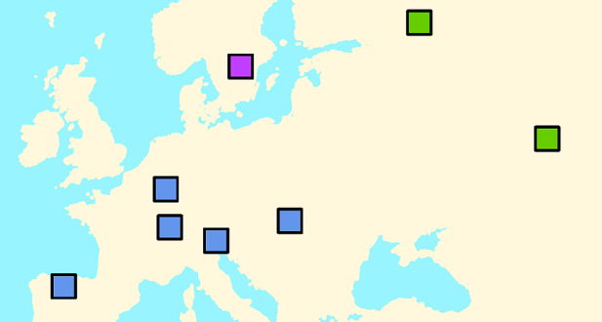
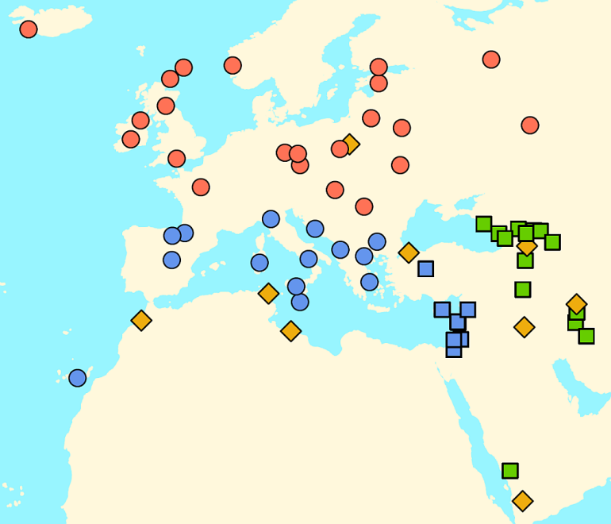
The third population arrives after 5,000 years ago
Haak et al. Nature 2015; Lazaridis et al. Nature 2017
Non-Mediterranean
Formation of modern Europe <5,000 years ago
Yamnaya steppe pastoralists
~6,000-5,000 years ago
Near East
European hunter-gatherers
>8,000 years ago
European and Anatolian farmers ~8,500-5,000 years ago
Present-day West Eurasian population structure
Europe
Mediterranean
Notes:
In a series of papers beginning in 2015, we showed how Europe’s ancestry transformed through movements and mixtures of people.
The first image shows an analysis of ~1,000 people from West Eurasia and ~600,000 positions in the genome; each dot in the plot is one of those people. Think of it as a grid of 600,000 rows and 1,000 columns… West Eurasians form two parallel lines.
The second image grays out these points, and we can now plot the positions of the ancients using the fact that the positions on the x-axis and y-axis are combinations of SNP values.
The third image shows the hunter-gatherers who fall beyond European sin the direction of European differentiation from the Near East.
The fourth image shows the farmers.
The fifth images shows the pastoralists of the Steppe (who carry Ancient North Eurasian ancestry), but present-day European mixed populations still haven’t formed.
The sixth image shows Europeans after 5,000 years ago.

Slide 17
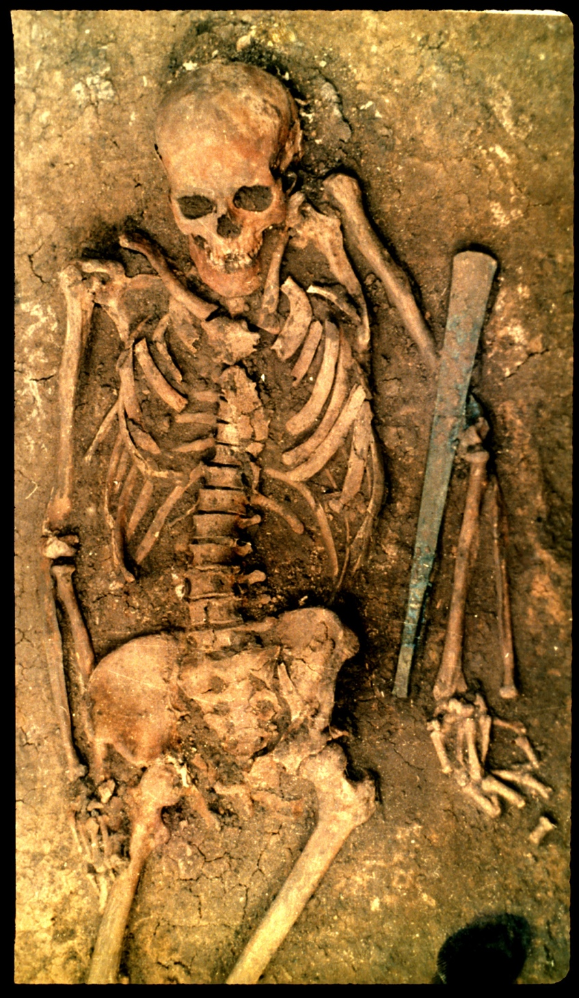
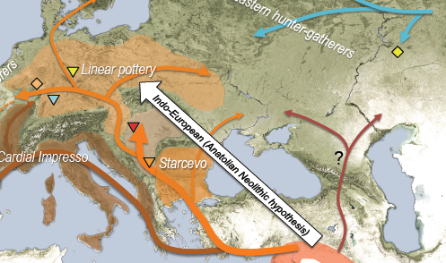
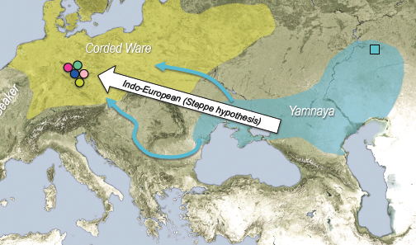
Summary: Europe massively transformed by two migrations
Haak et al. Nature 2015
Migration 1
Farmer Hunter-gatherer
Near Eastern Farmers
0% 20% 40% 60% 80% 100%
Farmers arrive, mix with local hunter-gatherers 8,500-5,000 years ago
Migration 2
Yamnaya
Yamnaya Steppe pastoralists
0% 20% 40% 60% 80% 100%
Who were the Yamnaya?
Yamnaya-farmer mix <5,000 years ago
Notes:
Done

Slide 18
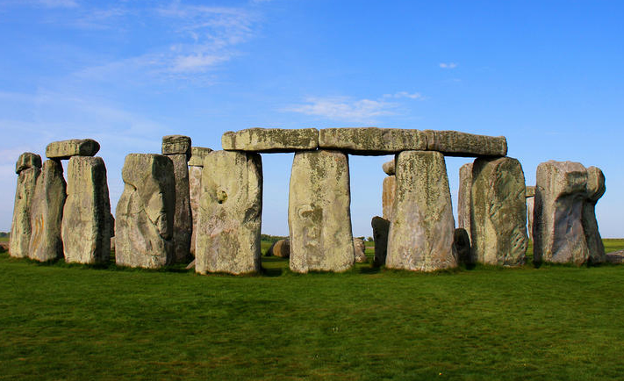
Yamnaya ancestry spreads West
Olalde et al. Nature 2018; Olalde et al. Science 2019
Britain
Iberia
~90% replacement
~40% replacement
Stonehenge
Iberia: 100% Y chromosome despite only 40% whole genome replacement
Notes:
Here’s how Yamnaya ancestry spread in Britain
First in Britain there was a ~90% replacement
- In Iberia there was a more modest ~40% replacement. But extraordinarily, there was a ~100% Y chromosome replacement, showing that incoming males had preferential access to local females.

Slide 19
Before 5,000 years ago Europeans were a mixture of two ancestries but today there is a third
Lazaridis et al. Nature 2014; Haak et al. Nature 2015
>5,000 years ago
Farmer Forager
Present day Europeans
Third ancestry
0% 20% 40% 60% 80% 100%
0% 20% 40% 60% 80% 100%
When did third ancestry arrive?
Notes:
In ancient DNA studies before 2015, we and others showed that prior to ~5,000 years ago there were just two primary ancestral populations in Europe: the hunter-gatherers and the farmers.
But today, thee was a third ancestral population.
When between these times did it arrive and in association with what archaeological cultures?

Slide 20
The third population arrives after 5,000 years ago
Haak et al. Nature 2015; Lazaridis et al. Nature 2017
Non-Mediterranean
Formation of modern Europe <5,000 years ago
Yamnaya steppe pastoralists
~6,000-5,000 years ago
Near East
European hunter-gatherers
>8,000 years ago
European and Anatolian farmers ~8,500-5,000 years ago
Present-day West Eurasian population structure
Europe
Mediterranean
Notes:
In a series of papers beginning in 2015, we showed how Europe’s ancestry transformed through movements and mixtures of people.
The first image shows an analysis of ~1,000 people from West Eurasia and ~600,000 positions in the genome; each dot in the plot is one of those people. Think of it as a grid of 600,000 rows and 1,000 columns… West Eurasians form two parallel lines.
The second image grays out these points, and we can now plot the positions of the ancients using the fact that the positions on the x-axis and y-axis are combinations of SNP values.
The third image shows the hunter-gatherers who fall beyond European sin the direction of European differentiation from the Near East.
The fourth image shows the farmers.
The fifth images shows the pastoralists of the Steppe (who carry Ancient North Eurasian ancestry), but present-day European mixed populations still haven’t formed.
The sixth image shows Europeans after 5,000 years ago.

Slide 21
Summary: Europe massively transformed by two migrations
Haak et al. Nature 2015
Migration 1
Farmer Hunter-gatherer
Near Eastern Farmers
0% 20% 40% 60% 80% 100%
Farmers arrive, mix with local hunter-gatherers 8,500-5,000 years ago
Migration 2
Yamnaya
Yamnaya Steppe pastoralists
0% 20% 40% 60% 80% 100%
Who were the Yamnaya?
Yamnaya-farmer mix <5,000 years ago
Notes:
Done

Slide 22
Yamnaya ancestry spreads West
Olalde et al. Nature 2018; Olalde et al. Science 2019
Britain
Iberia
~90% replacement
~40% replacement
Stonehenge
Iberia: 100% Y chromosome despite only 40% whole genome replacement
Notes:
Here’s how Yamnaya ancestry spread in Britain
First in Britain there was a ~90% replacement
- In Iberia there was a more modest ~40% replacement. But extraordinarily, there was a ~100% Y chromosome replacement, showing that incoming males had preferential access to local females.

Slide 23
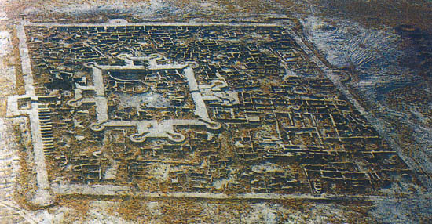
Third surprise: Yamnaya ancestry spreads East
Narasimhan, Patterson et al. Science 2019
Bactria Margiana Archaeological Complex 4,300-3,700 years ago
Gonur, Turkmenistan
524 ancient genomes
Genetically similar to ancient farmers from Iran
>260 modern populations
Forager ancestry in outliers >4,000 years ago
Yamnaya ancestry in outliers <4,000 years ago
in Pakistan >3,500 years ago
11 outliers admixed with South Asian ancestry
Notes:
Done

Slide 24
Three layers of mixture in South Asia
Narasimhan et al. Science 2019
<2000 BCE “Steppe Cline”
“ANI” – Ancestral North Indians
“Indian Cline”
“ASI” - “Ancestral South Indians”
>2000 BCE ”Indus Periphery Cline”
>2000 BCE ”Indus Valley Cline”
Notes:
Resolution is low
Change BCE to BP

Slide 25
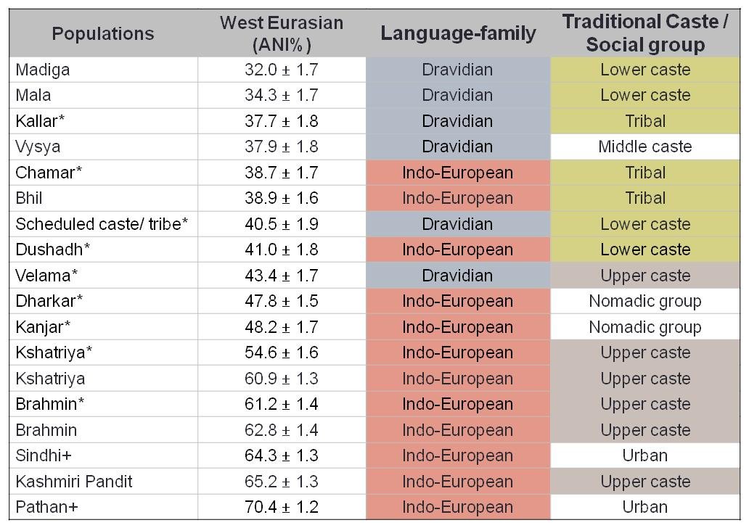
Indian mixture correlates strongly to language and culture
West Eurasian-related ancestry is 20-80% and is significantly correlated to caste and language

Slide 26
Extraordinarily High Population Structure in India Today
Indian groups are much more genetically differentiated than Europeans
 | India | Europe
Average F_{ST} | 0.010 | 0.003
By language group
Indo-European 0.008
Dravidian 0.007
By social status
Upper caste 0.006
Lower caste 0.009
By state
Uttar Pradesh 0.010
Andhra Pradesh 0.007
India is not a large population, but instead many small populations
Reich et al. Nature 2009

Slide 27
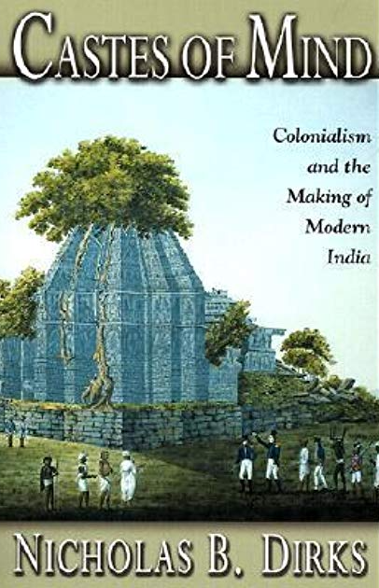
The Founder Events are Old
For example in Vysya from Andhra Pradesh, 2000-3000 years old
Some have argued that ‘caste’ in modern India is an ‘invention’ of colonialism, in the sense that it became more rigid under colonial rule.
Genetics shows that many current distinctions among castes are ancient and strong endogamy must have shaped marriage patterns for thousands of years.
Genetics has documented a cultural change
- After 4,000 years ago, convulsive mixture to form ANI and ASI which then mixed in turn
- A profound switch to endogamy, partly intact today

Slide 28
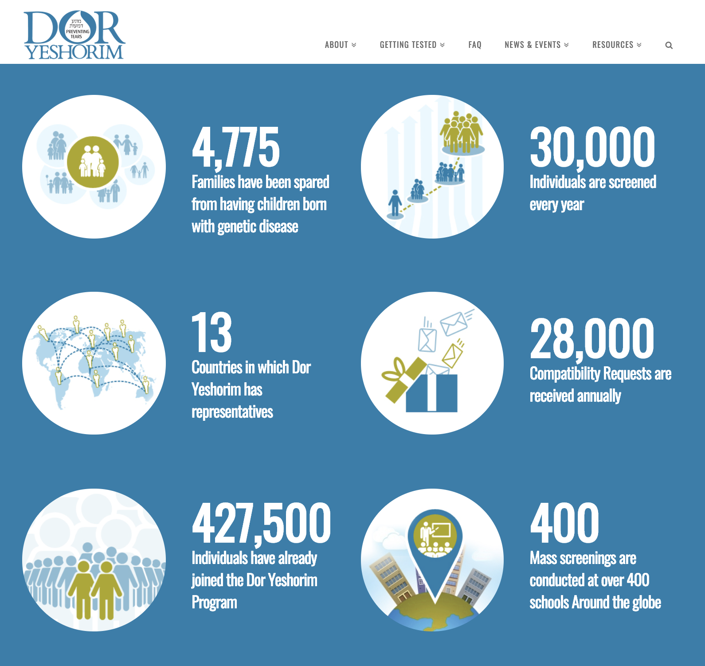
Personal Note: I myself come from an ancient caste that experienced a strong founder event: Jews
This is a useful perfective for thinking about founder population structure in India
Jews are afflicted by many rare diseases due to an ancient founder event
Notes:
A major focus of my lab has also always been and continues to be to use the historical approach to gain insight into human disease.
When I began my lab, my focus was on using the history of mixture between African and European Americans to gain insight into genetic contributions to the health disparities in the two groups, a research program that resulted in more than 30 papers between 2003-2012.
Now, what I am most excited about in this area is the opportunity for addressing health outcomes in India, where my work has shown that about 1/3 of groups have founder events as strong or stronger than Ashkenazi Jews, who descend from a relatively small number of individuals ~500 years ago who had many offspring and whose rare disease causing mutations got jacked up in frequency.
Here is a plot of founder event strengths in a survey we did last year
The Vysya are an example with Butylcholinesterase deficiency.
And there are many groups with census sizes of millions with clinically significant founder events.
A back of the envelope calculations suggests up to 100,000 new disease cases per year due to these founder events and these are not a focus of systematic study.
Finding the causal mutations is conceptually simple and not very expensive with modern methods, and there are particular opportunities for intervention in India because of arranged marriage.
Currently, I’m addressing this in concert with my long-standing collaborators in Hyderabad, exome sequencing the at-risk groups in India to identify predicted disease causing mutations.
It is nearly impossible to export biological material from India, and my goal here is to facilitate; to help prove the principle and power of this approach through collaboration, and to help seed Indian groups that will take the lead on such analyses.

Slide 29
A huge medical opportunity in India
Reich et al. Nature 2009; Nakatsuka et al. Nature Genetics 2017
Pattapu Kapu
(13,700,000)
Founder events stronger than those in Ashkenazi Jews
Founder event strength relative to Ashkenazi Jews
Example: 1/3 of Indians are from groups with clinically significant founder events thus high risk for recessive disease: Nakatsuka et al. Nature Genetics 2017
Up to 100,000 predicted disease cases per year
Kshatriya Aqnikula
(12,800,000)
Vadde
(3,700,000)
Baniyas
(4,200,000)
Prenatal testing and premarriage counseling
Kumhar
(3,100,000)
Survey for mutations by sequencing at-risk groups
Reddy
(22,500,000)
Kallar
(2,400,000)
Butyrylcholinesterase deficiency
(Manoharan et al. Pharm. Genomics 2006)
Vysya
(3,200,000)
Jews = 1
Indian groups ranked by strength of founder event
Notes:
A major focus of my lab has also always been and continues to be to use the historical approach to gain insight into human disease.
When I began my lab, my focus was on using the history of mixture between African and European Americans to gain insight into genetic contributions to the health disparities in the two groups, a research program that resulted in more than 30 papers between 2003-2012.
Now, what I am most excited about in this area is the opportunity for addressing health outcomes in India, where my work has shown that about 1/3 of groups have founder events as strong or stronger than Ashkenazi Jews, who descend from a relatively small number of individuals ~500 years ago who had many offspring and whose rare disease causing mutations got jacked up in frequency.
Here is a plot of founder event strengths in a survey we did last year
The Vysya are an example with Butylcholinesterase deficiency.
And there are many groups with census sizes of millions with clinically significant founder events.
A back of the envelope calculations suggests up to 100,000 new disease cases per year due to these founder events and these are not a focus of systematic study.
Finding the causal mutations is conceptually simple and not very expensive with modern methods, and there are particular opportunities for intervention in India because of arranged marriage.
Currently, I’m addressing this in concert with my long-standing collaborators in Hyderabad, exome sequencing the at-risk groups in India to identify predicted disease causing mutations.
It is nearly impossible to export biological material from India, and my goal here is to facilitate; to help prove the principle and power of this approach through collaboration, and to help seed Indian groups that will take the lead on such analyses.

Slide 30
Fourth surprise
Ancient DNA challenges many previous ”just so” stories on natural selection on particular genetic variants coinciding with the start of agriculture

Slide 31
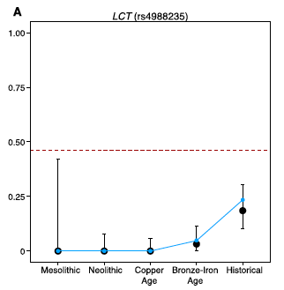
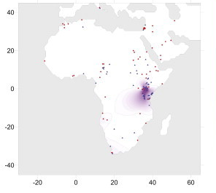
Conjecture #1:
Lactase persistence arose in north Europe due to dairying in early European farmers
Truth:
Only rose to high frequency thousands of years after the rise of intensive dairying
(2) Similarly in East African first pastoralists only 1 of 37 people 4000-1000 years ago had lactase persistence
(3) And actually, lactase persistence arose in the Steppe not Europe
Arose in the Steppe not Central Europe
Haak, Lazaridis et al. Nature 2015; Allentoft et al. Nature 2015; Mathieson et al. Nature 2018
Olalde et al. Science 2019
Tishkoff et al. Nat. Genetics 2007; Prendergast et al. Science 2019

Slide 32
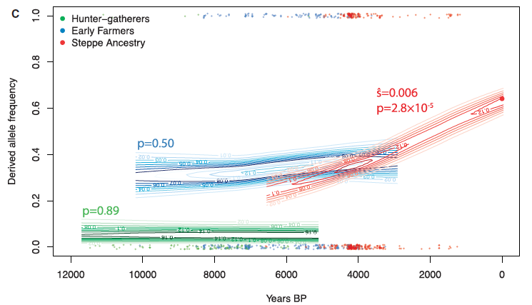
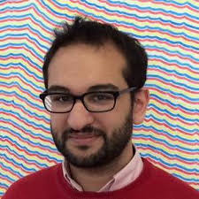
Conjecture #2:
An allele at FADS1/FADS2 that aids in digestion of linoleic acids that are more common in farmer diets was selected in Europe beginning with agriculture
Truth: Selection for this allele began only in the Bronze Age amid people with Steppe ancestry
Mathieson and Mathieson MBE 2018

Slide 33
Conjecture #3:
Blue eyes rose to high frequency under selection pressure for skin-lightening related to nutrient deficiencies associated with agriculture
Truth: Blue eyes were already at high frequency in late Western European hunter-gatherers
But not at high frequency in eastern and central European hunter-gatherers
Olalde et al. Nature 2014; Lazaridis et al. Nature 2015; Brace et al. Nat. Ecol. Evol, 2019

Slide 34
Conjecture #4:
Light skin pigmentation rose to high frequency under selection pressure to address vitamin D deficiencies associated with agriculture
Truth: Light skin was already common in eastern European and Scandinavian hunter-gatherers
La Braña: Olalde et al. 2014
Cheddar Man: Brace et al. 2019

Slide 35
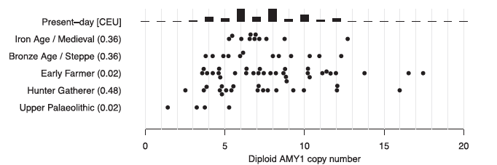
Disproven conjecture #5: Increase in salivary amylase copies is adaptation to farming
Truth: High amylase copy number was already established in late European hunter-gatherers
Mathieson and Mathieson MBE 2018

Slide 36



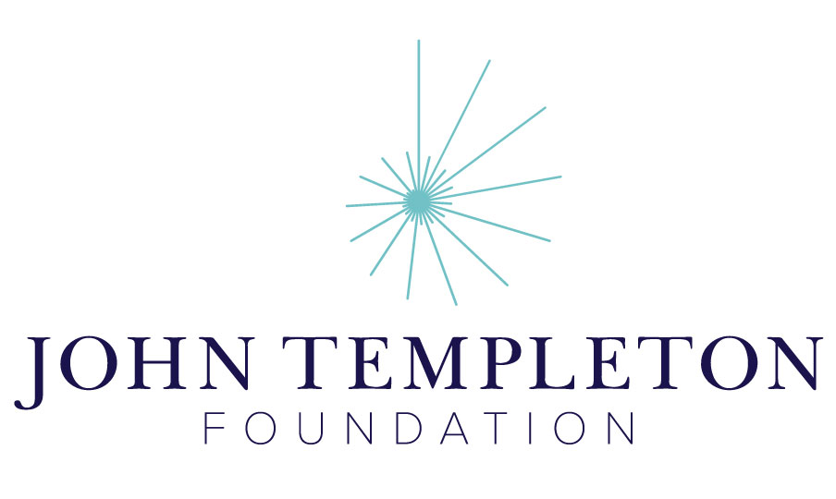
Summary
People in our laboratory
(and many collaborators and past lab members)
Ancient DNA is showing us that much of what we thought we knew is wrong about human biology in the past is wrong
Grant Support
Notes:
At the end of this talk I hope you will be convinced that population history is not just interesting in its own right.
The goal of this talk is to convince you that the historical perspective provides insights about biology that are profoundly important and are difficult to obtain with other approaches.

